Slide 1
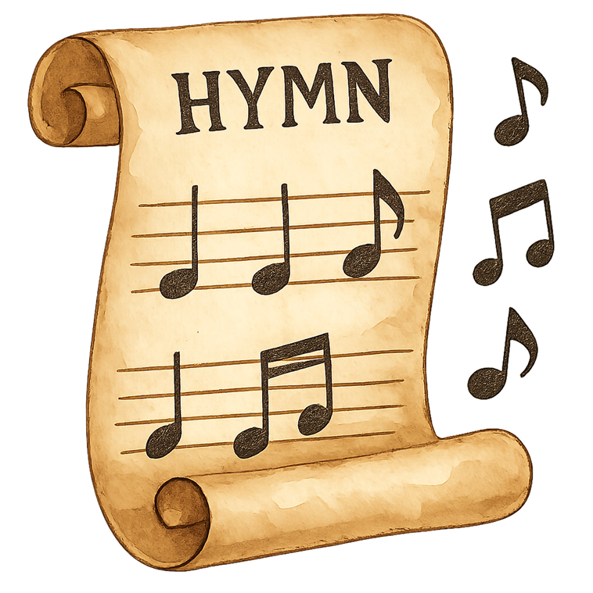
SUMMER ADULT SUNDAY SCHOOL
Wesley Chapel (downstairs)
10:00-11:00 a.m. Sundays
“A Wesleyan Hymn Study”
Joyfully singing and discussing the hymns of
John and Charles Wesley.
Contact: David Nielson

